Slide 1


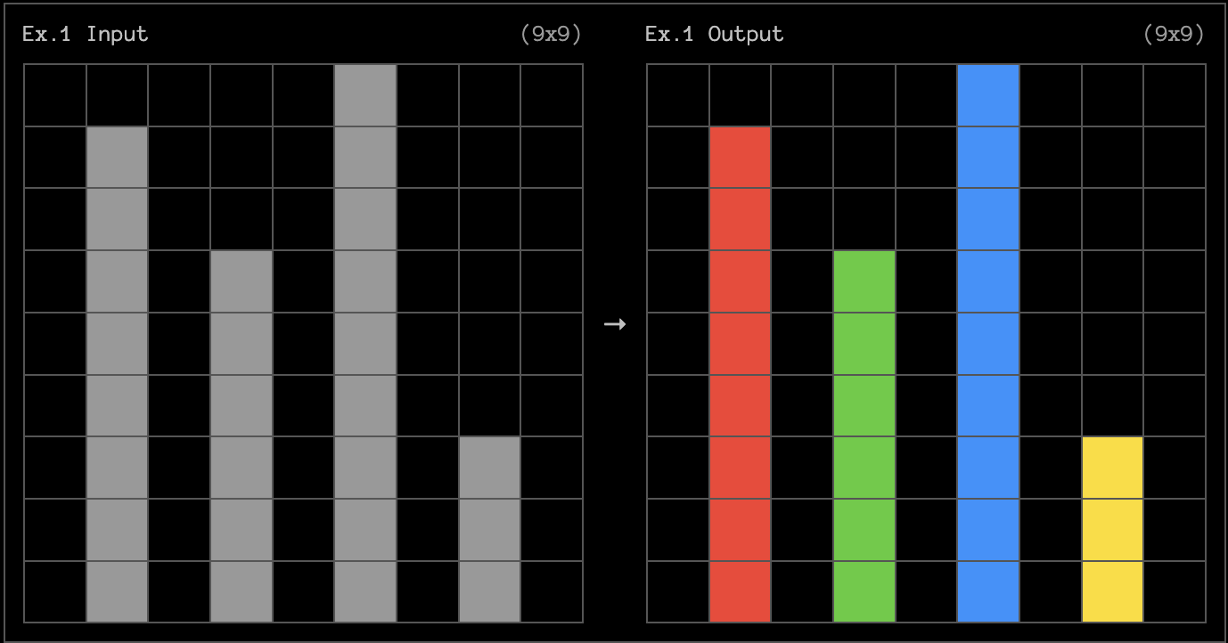
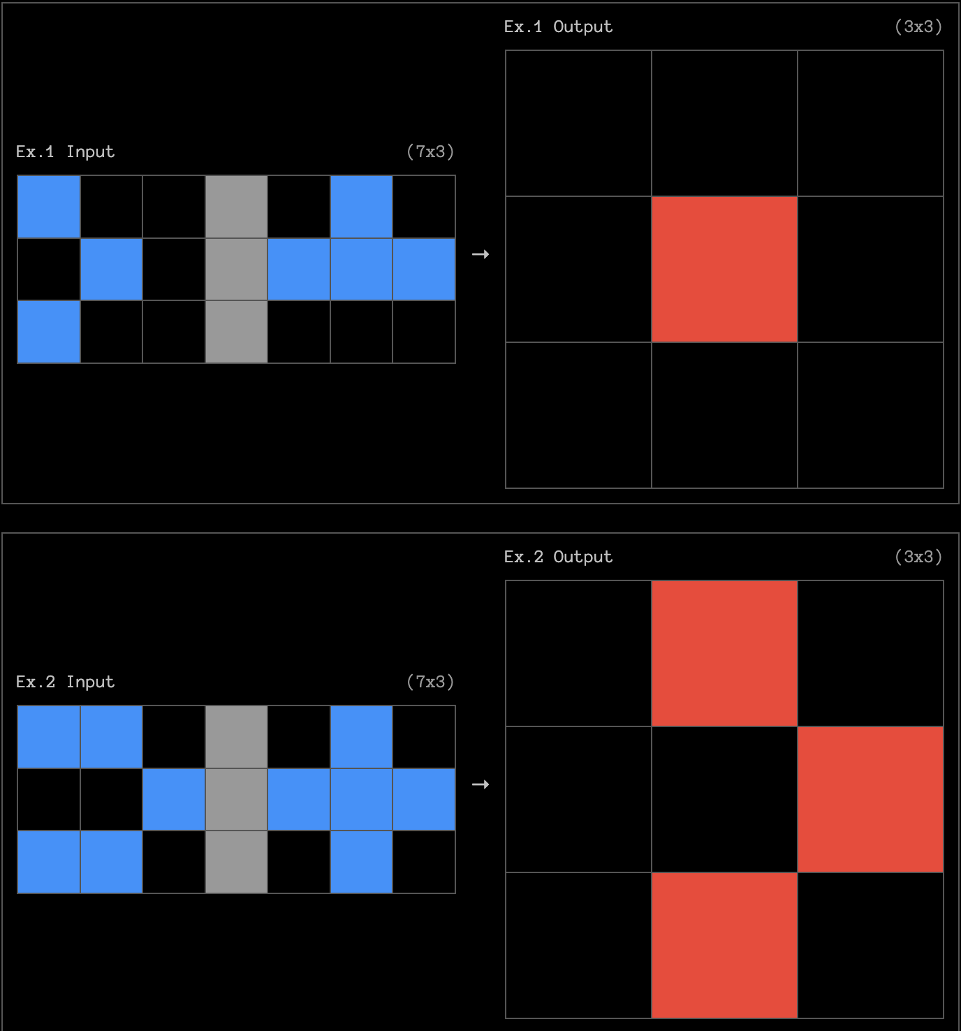
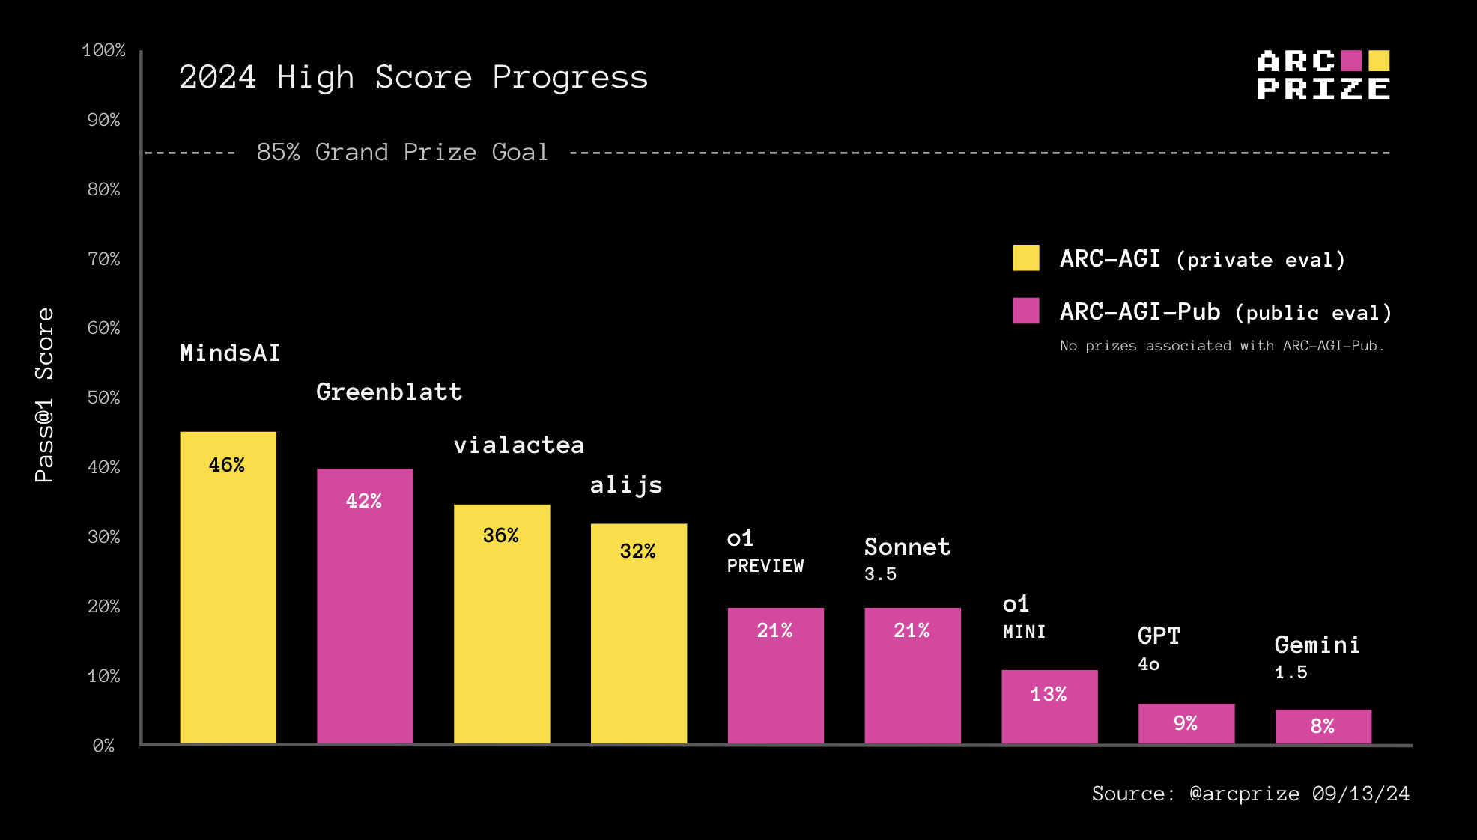
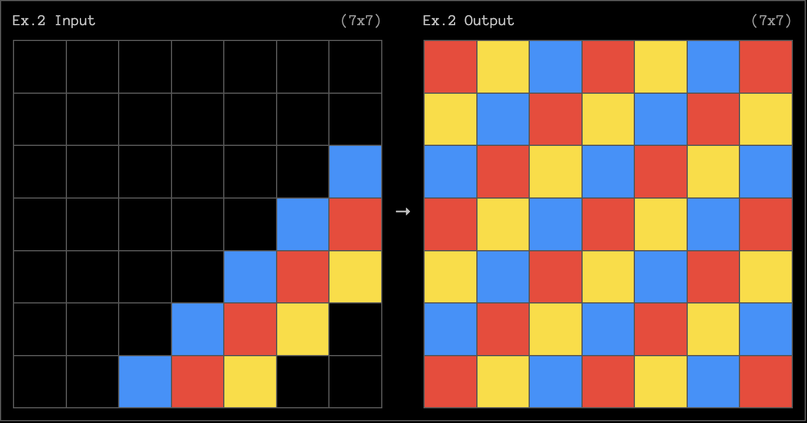
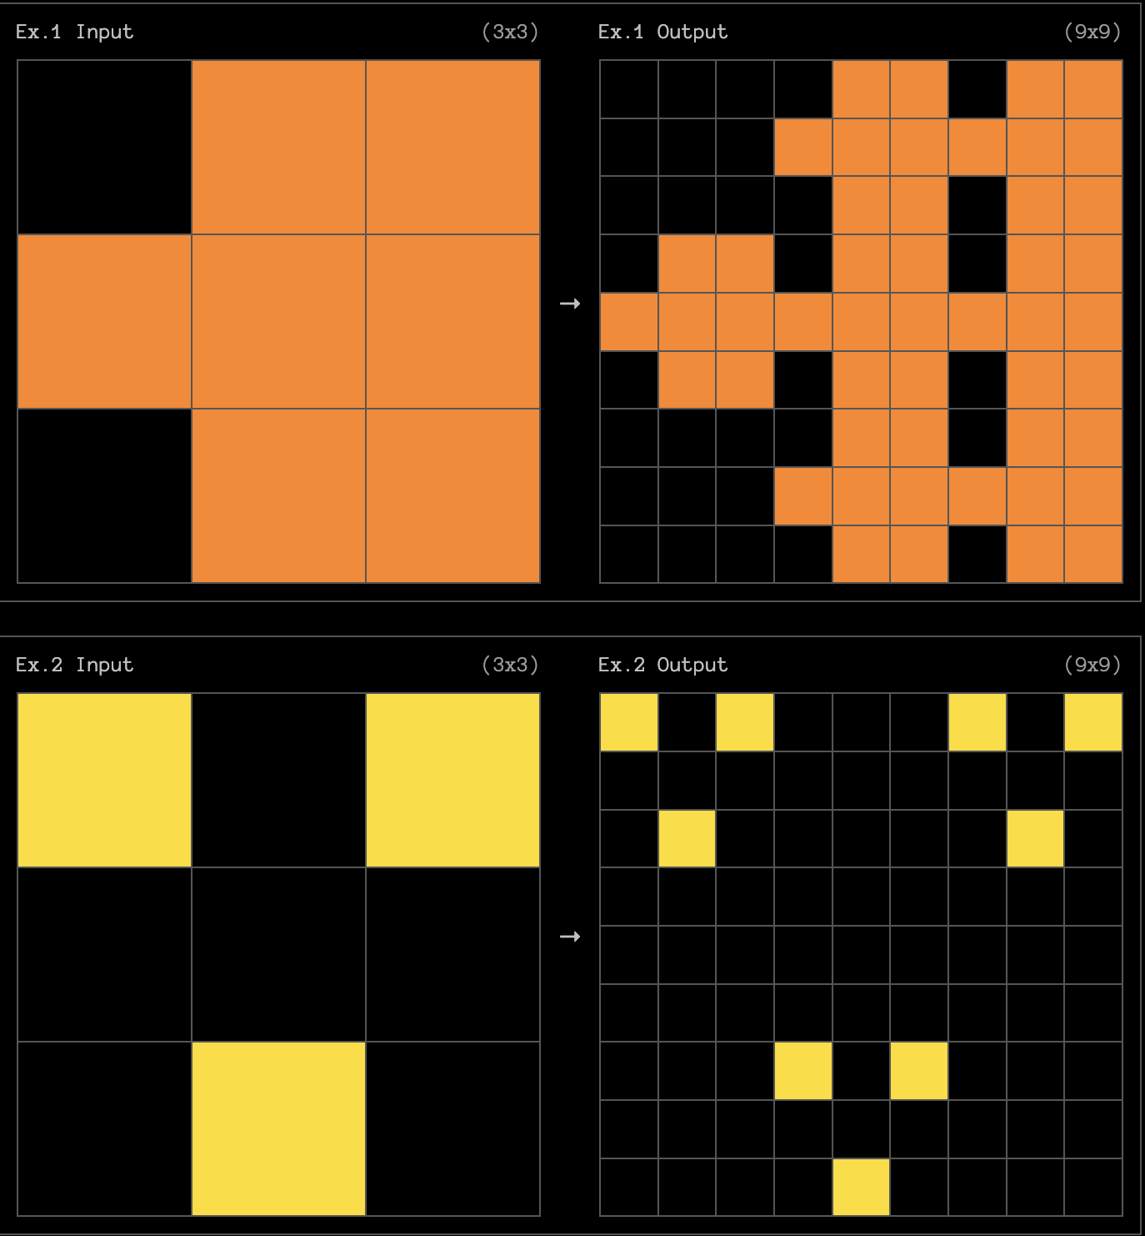
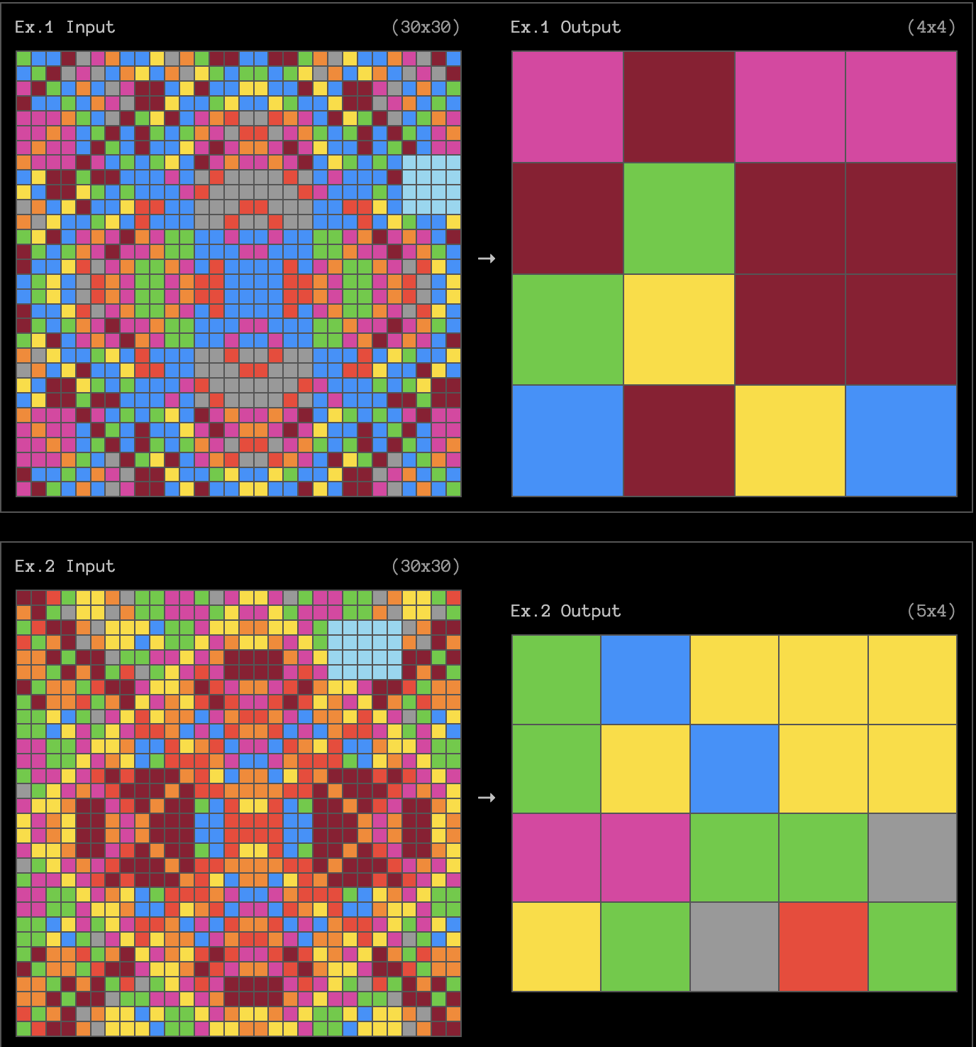
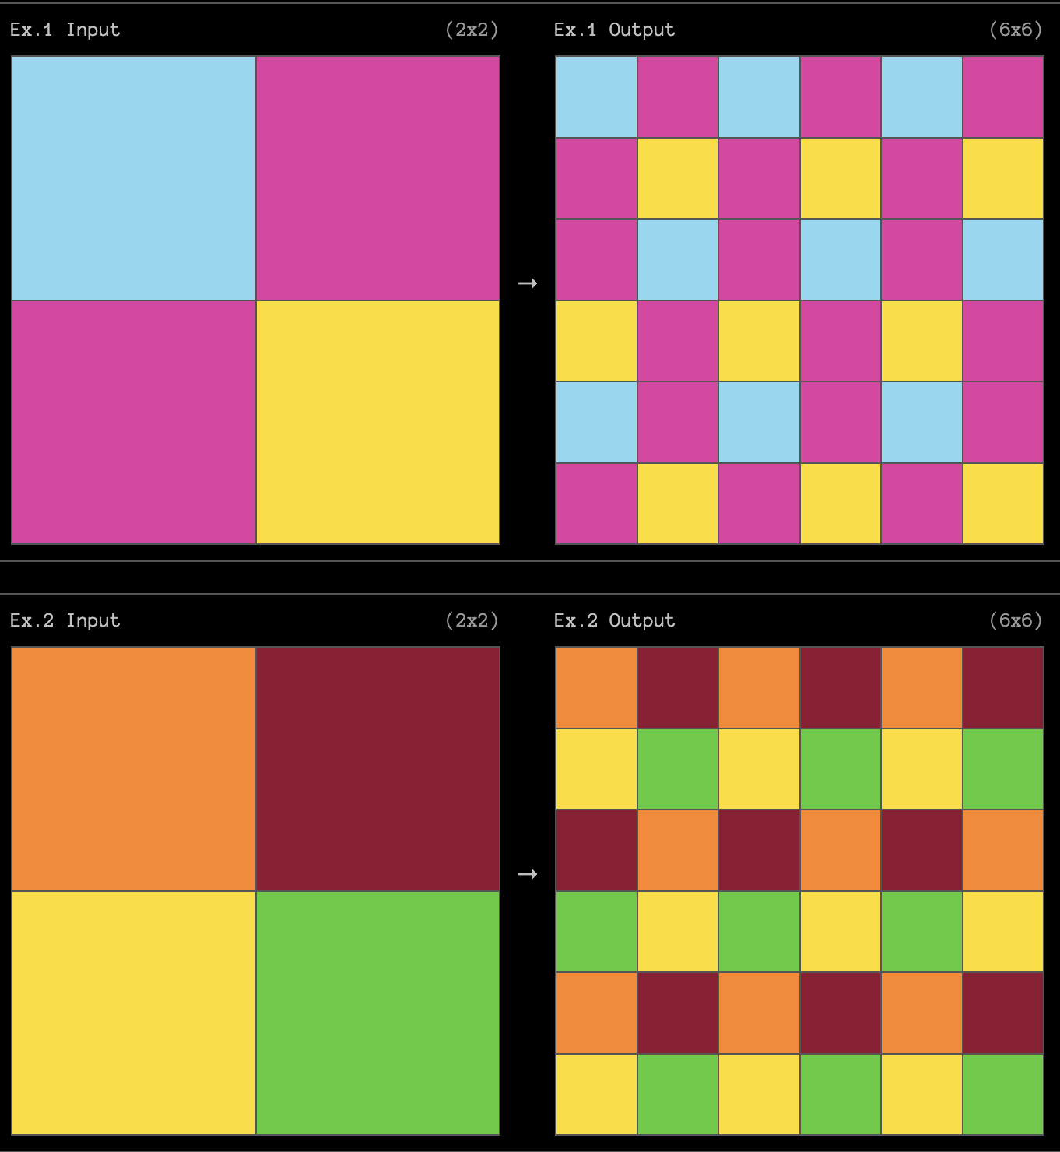
Solving ARC, KBAI Style.
Aishwarya Solanki
Introduction
Focus: Addressing the ARC Prize Challenge, a benchmark for AGI, requiring complex reasoning tasks.
Objective: To leverage Knowledge-Based AI principles for solving ARC problems.
Motivation: ARC tasks emphasize human-like reasoning, making them ideal for testing AI generalization.
Challenges range from simple pattern recognition to multi-object transformations.
Approach: Applying structured reasoning (e.g., pattern matching, concept learning) to tackle diverse ARC tasks.
Above are the examples of some of my favorite ARC challenges, easy to hard in that order.
My attempted work draws heavy inspiration from Knowledge-Based AI (KBAI), which emphasizes structured knowledge and reasoning processes to simulate human cognition.
The ARC Prize Challenge provides a perfect platform to apply and test these methodologies in an environment designed to reward robust solutions to highly complex problems.
Methodology
I aim to use a divide and conquer mechanism and divide the ARC challenges into sub-categories that can be conquered using various KBAI fundamentals.
Pattern Matching: Identifying repeating structures and using unification for generalization.
Knowledge Representation: Using frames and semantic networks for organizing grid objects and relationships.
Search and Planning:
Rule-based reasoning for grid transformations.
Case-based reasoning to adapt solutions from similar problems.
Concept Learning: Learning abstract rules from examples for better generalization.
Future Work
Refine the divide-and-conquer framework for better handling of diverse ARC task types.
I also want to experiment with advanced KBAI techniques, such as Hierarchical Task Networks.
With LLMs I want to try pre-training and fine-tuning techniques to conclude if the modern day LLMs can reach an accuracy score of 50%+.
I plan to try different techniques, hyper parameter settings, and divide the ARC dataset into an appropriate train-validation-test split to get the best results.
References
Arc Prize official Site - https://arcprize.org/
Garcez, A. d., Gori, M., Lamb, L. C., Serafini, L., Spranger, M., & Tran, S. N. (2019). Neural-Symbolic Computing: An Effective Methodology for Principled Integration of Machine Learning and Reasoning. arxiv:1905.06088.
Chollet, F. et al. (2019). On the Measure of Intelligence. arxiv:1911.01547.
J. C. Min Tan and M. Motani, "LLMs as a System of Multiple Expert Agents: An Approach to Solve the Abstraction and Reasoning Corpus (ARC) Challenge,"
Kaggle submission - https://www.kaggle.com/code/minseo14/arc-with-rnn
Results
Successfully solved simple pattern-matching tasks, such as replicating patterns and flipping grid colors.
Struggled with complicated tasks.
Gradescope score – 1/400

